Slide 1
BUS Reservation System
Student name:R.Annapoorani
Student ID:620221104301
College name:AMSEC
College code:6202

Slide 2
Abstract
▶ Online Bus Ticket Reservation System is a web-based application that works within a file. One network. This
▶ project introduces an update to the software program “Online Bus Ticket Reservation System ”as it should be
▶ used in the bus system, the area used reserved seats, booking cancellations and various types of route inquiries
▶ used for security quick booking.
▶ OBTRS is designed to manage and compile a traditional database, ticket
▶ booking and bus tracking and departure made.

Slide 3
INTRODUCTION
Background of Study
. A common view in various circles of the world is that man now lives in the growth of years of data collection,
processing and distribution, is very popular years of knowledge called. For this reason, managers and other data users especially in the transportation industry are looking for more types of management and operational support details. So they have to answer there is a growing need for information and data management.
Electronic tickets, or e-tickets, provide proof that their owners have permission to enter the amusement park,
use a travel item, or have it access to other Internet services

Slide 4
Statement of Problem
▶ Currently, the type of system used in the counter is the internal system used manually to sell bus tickets.
▶ The company’s problems are that customers have to go to the counter to buy
a bus ticket or ask for a bus system,
▶ customers will also have to wait in line for longer to get a bus ticket and will also have to pay cash when they
▶ buy a bus ticket.

Slide 5
Objectives of study
▶ The main purpose of this study is to implement flexible procedures for booking a bus ticket for any trip made.
▶ by Imo Transport Company (ITC). The system is said to be the default system and customers can choose their.
▶ own seats. Specifically, the objectives of this project will be to:
▶ i) Provide a web-based bus booking service where a customer can Buy a bus ticket online without
the need to
▶ line up counter to buy a bus ticket.
▶ Ii) Empowering customers to check availability and types of buses online. The customer can check
the timing of
▶ the entire ITC bus by using system.
▶ iii) Facilitating the payment of bus tickets by obtaining a bank pin after payment various designated banks.
▶ iv) The ability of customers to cancel their booking.
▶ v) User management rights in renewal and cancellation of payment, route and vehicle Records

Slide 6
Problem Statement
▶ Traditional bus ticket booking systems are often time-consuming and inefficient, leading to inconvenience for both passengers and bus operators.
▶ There is a need for a modern, user-friendly bus reservation system that simplifies the booking process and enhances overall efficiency.

Slide 7
Project Overview
▶ The bus reservation system will consist of a user interface for passengers to search for buses, view schedules, select seats, and make payments securely.
▶ Additionally, there will be an admin interface for bus operators to manage routes, schedules, ticket prices, and passenger bookings.

Slide 8
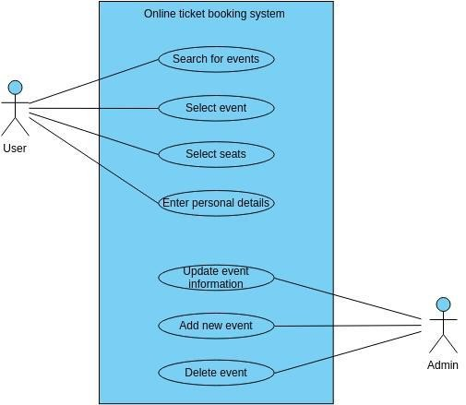

Slide 9
Technology View
▶ Frontend: HTML, CSS, JavaScript, React.js
▶ Backend: Node.js, Express.js
▶ Database: MongoDB
▶ Payment Integration: Stripe API
▶ Authentication: JSON Web Tokens (JWT)
▶ Deployment: AWS or Heroku

Slide 10
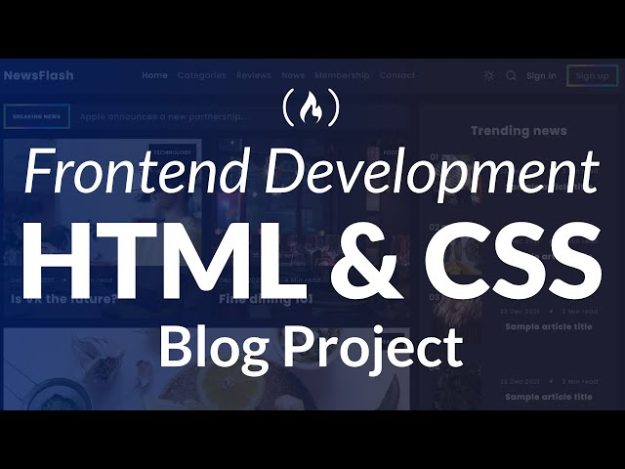
Frontend

Slide 11

Backend

Slide 12
Modeling and Results
▶ The system will include a relational database model to store information about buses, routes, schedules, seats, passengers, and transactions.
▶ Results will include improved efficiency in booking tickets, reduced waiting times, and better management of bus operations.

Slide 13
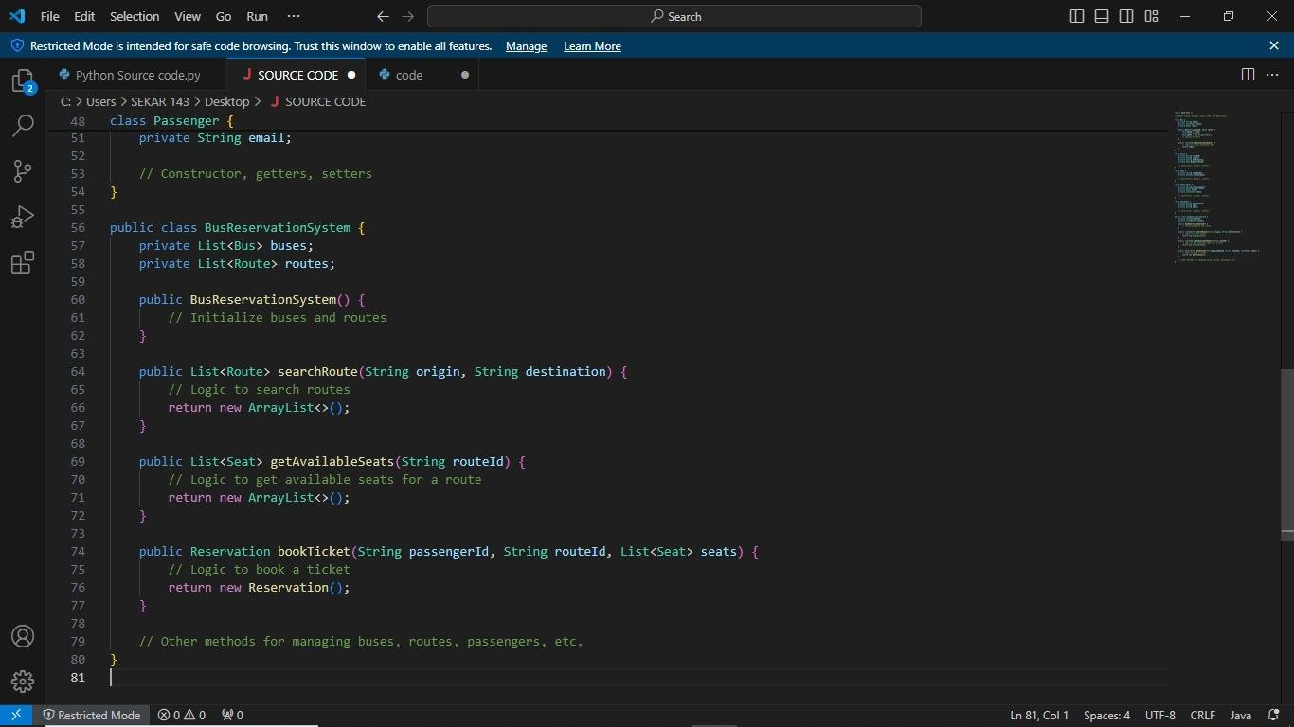
Screen Shot

Slide 14
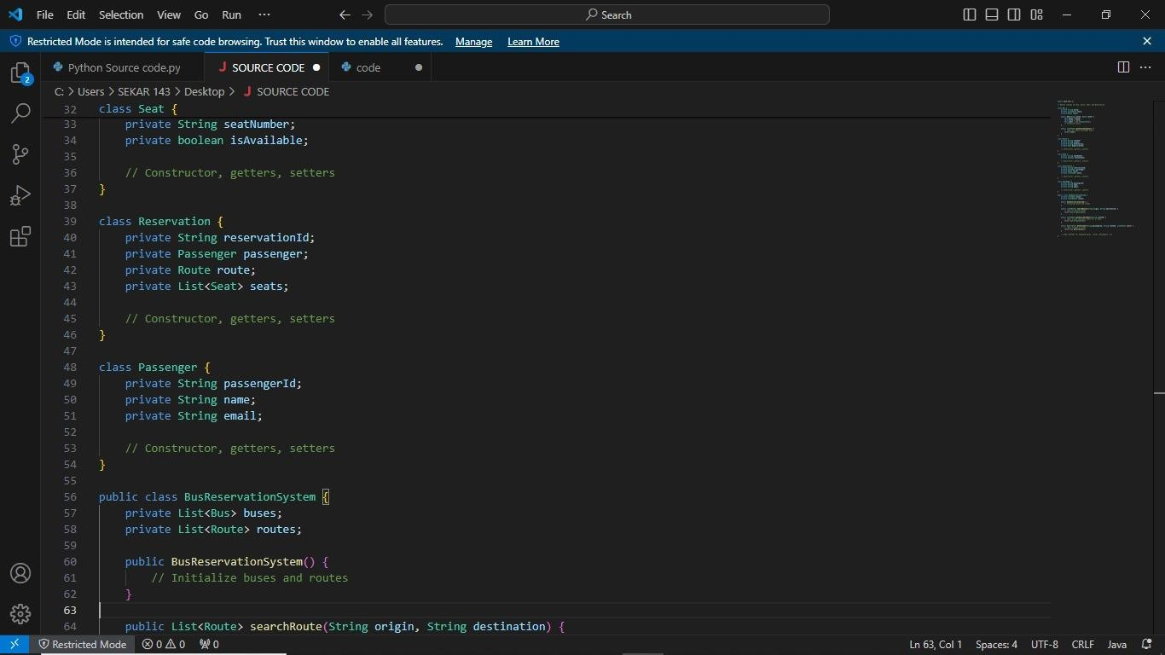

Slide 15
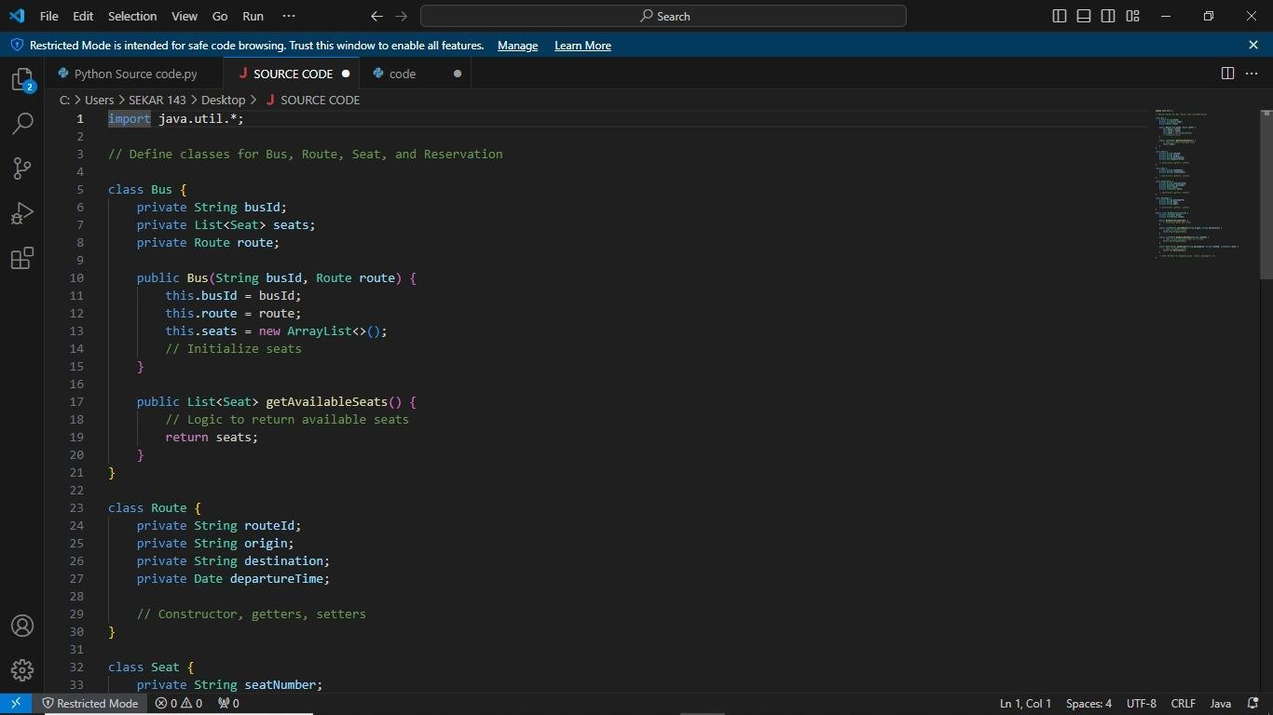

Slide 16
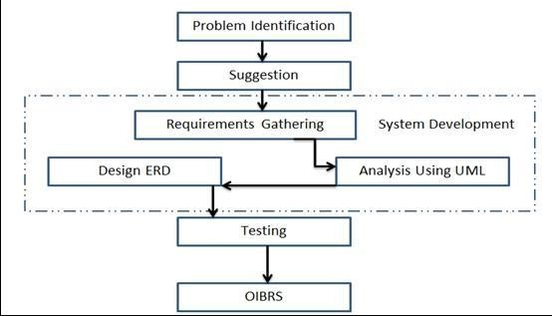
Future Enhancement

Slide 17
MODELING AND ANALYSIS
▶ Inputs & Output Designs
▶ Design to insert a link between the information system and the user. It contains advanced specifications and
▶ data processing procedures and those steps are required to incorporate transaction data into a usable data
▶ processing form while designing the process involves designing the required re
▶ sults in the form of reports to be
▶ Provided to users according to needs. Below are some screenshots with the input and output designs of the
▶ proposed system..

Slide 18
RESULTS AND DISCUSSION
▶ In 1974, American airline became the first to use an automated booking system, which was almost by hand.
▶ Technology has grown, and computer booking has the system was built. In the current era, online booking or
▶ booking system improve the performance of various sectors of the country’s
economy this program. An online
▶ bus ticket booking system is a web-based system ensures that the company will be able to change most of the
▶ processes carried out log out manually into automatic, error-free and easy-to- use operation organization
▶ especially in the area of transport;

Slide 19
CONCLUSION
▶ It can be seen that computer applications are very important in every field of human endeavor. Here with this
▶ new system all the information about the customer making a reservation can be obtained by clicking a button,
▶ removing some of the difficulties that come with the manual system. This will reduce the workload of the
▶ employees, reduce the time taken to make reservations at the bus terminal and will also increase the efficiency.

Slide 20
It can be seen that computer applications are very important in every field of human endeavor. Here with this
new system all the information about the customer making a reservation can be obtained by clicking a button,
removing some of the difficulties that come with the manual system. This will reduce the workload of the employees, reduce the time taken to make reservations at the bus terminal and will also increase the efficiency.

Slide 21
THANK YOU

